Slide 1
Automating SAP Technical Specification and Code Generation with AI Agents
An Innovative Approach to Enhance Efficiency and Accuracy

Slide 2
Introduction
This presentation outlines the use of AI agents to automate the generation of Technical Specification Documents (TSD) and ABAP code from WRICEF functional documents in SAP projects.

Slide 3
WRICEF Functional Documents and TS Generation
WRICEF (Workflow, Reports, Interfaces, Conversions, Enhancements, Forms) functional documents are essential in SAP projects, providing detailed functional requirements for custom developments.
AI agents will analyze WRICEF functional documents to extract relevant information and automatically generate comprehensive Technical Specification Documents (TSD).

Slide 4
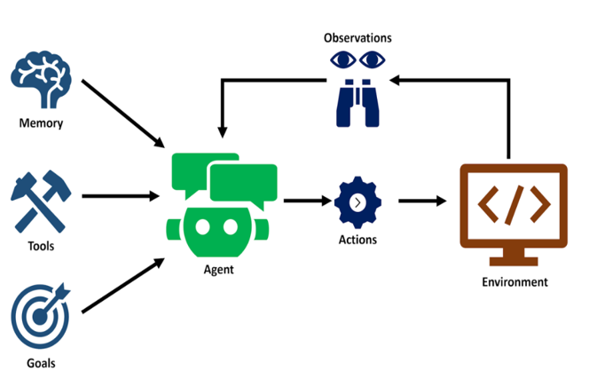
Benefits and Advantages
Using AI agents for this process offers numerous benefits, including increased efficiency, higher accuracy, reduced manual effort, and faster turnaround times for SAP projects.

Slide 5


Automating Technical Specification Document Using AI Agents
Generated TSD
Section 1
WRICEF Functional Documents
Tech Spec 1
Section 2
Tech Spec 2
Section 3
Tech Spec 3
Code Dumps
Pseudocode
Pseudocode

Slide 6
Generating ABAP Code from TSD
Based on the Technical Specification Documents, AI agents will generate the corresponding ABAP code, ensuring alignment with the specified requirements and standards.
AI agents will generate code for individual SAP modules and handle the merging process to ensure seamless integration of the code across different modules.

Slide 7
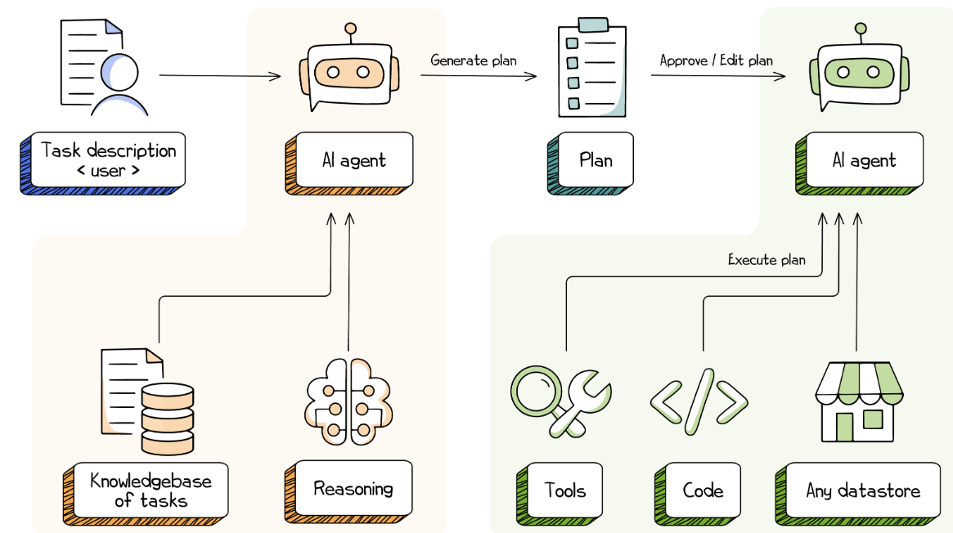
AI agents automating Code Generation
Generate Modules
WRICEF TSD
Generate Modules

Slide 8
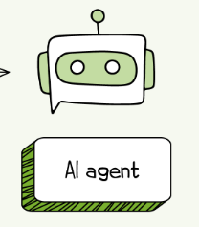
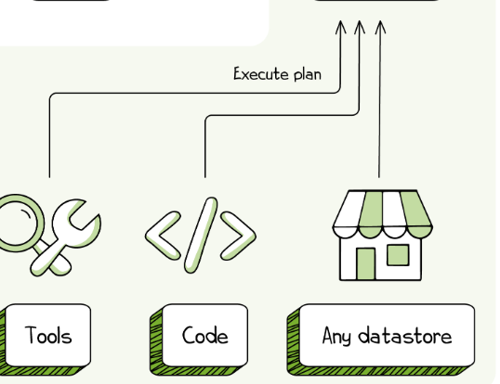
Modular Code Generation
Merging

Slide 9
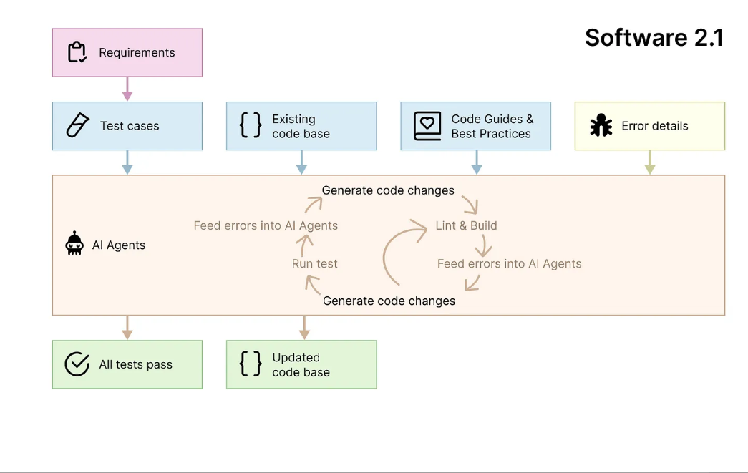
AI agents updating Existing Code Base
Future Enhancements

Slide 10
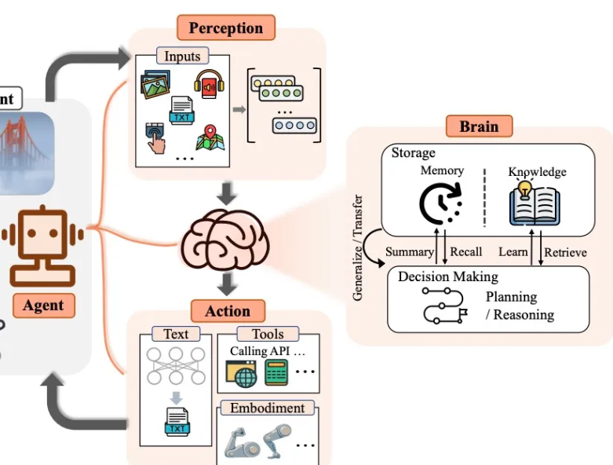
FSD to TSD
TSD to ABAP Code

Slide 11
Benefits and Advantages
Increased Efficiency
Higher Accuracy
Reduced Manual Effort
Faster Turnaround Times

Slide 12
Conclusion
AI-driven automation of TSD and ABAP code generation from WRICEF functional documents is a transformative approach that enhances productivity and ensures consistency in SAP projects.

